Slide 1
DEPARTMENT OF PHYSICS
SRM INSTITUTE OF SCIENCE AND TECHNOLOGY
18PYB103J –Semiconductor Physics
Lecture 3
KRONING PENNEY MODEL
18PYB103J Module-I Lecture-3

Slide 2
Kroning Penney model :
According to Kroning and Penney the electrons move in a periodic square well potential.
This potential is produced by the positive ions (ionized atoms) in the lattice.
The potential is zero near to the nucleus of positive ions and maximum between the adjacent nuclei. The variation of potential is shown in figure.
18PYB103J Module-I Lecture-3

Slide 3
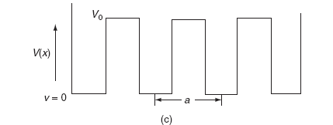
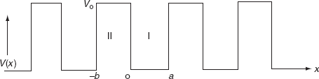

It is not easy to solve Schrödinger’s equation with these potentials. So, Kroning and Penney approximated these potentials inside the crystal to the shape of rectangular steps as shown in Fig. (c). This model is called Kroning-Penney model of potentials.
The energies of electrons can be known by solving Schrödinger’s wave equation in such a lattice. The Schrödinger time-independent wave equation for the motion of an electron along X-direction is given by:
The energies and wave functions of electrons associated with this model can be calculated by solving time-independent one-dimensional Schrödinger’s wave equations for the two regions I and II as shown in Fig
18PYB103J Module-I Lecture-3

Slide 4




The Schrödinger’s equations are:
for 0<x<a.............(2)
for -b<x<0.............(3)
We define two real quantities (say) α and β such that:
for 0<x<a
for -b<x<0
The total wave function is therefore of the form
18PYB103J Module-I Lecture-3

Slide 5
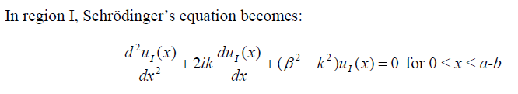

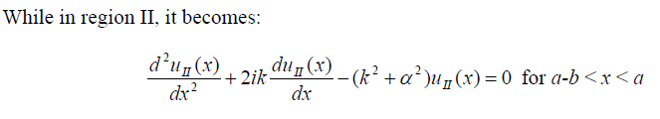

where u(x) is the periodic function as defined by u(x) = u(x + a), and k(x) is the wave number. Rewriting the wave function in such form allows the simplification of the Schrödinger equation, which we now apply to region I, between the barriers where V(x) = 0 and region II, the barrier region where V(x) = V₀:
18PYB103J Module-I Lecture-3

Slide 6

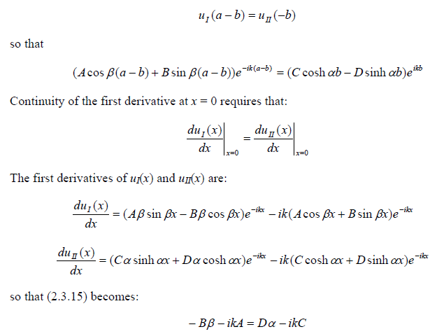
18PYB103J Module-I Lecture-3

Slide 7
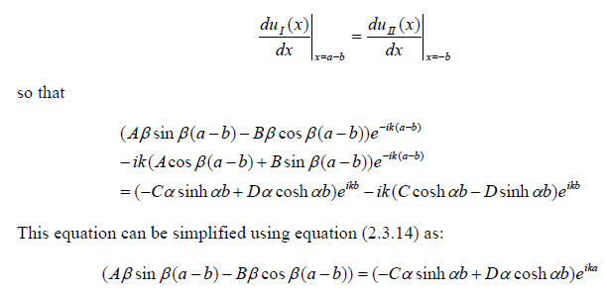
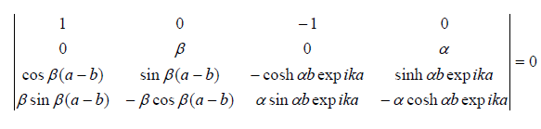
18PYB103J Module-I Lecture-3

Slide 8
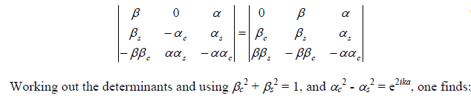
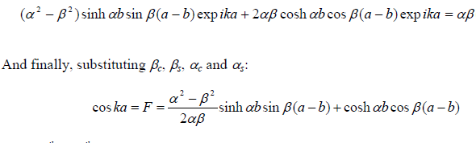
18PYB103J Module-I Lecture-3

